Slide 1


INTRODUCTION TO HTML AND CSS
Hemanth S

Slide 2
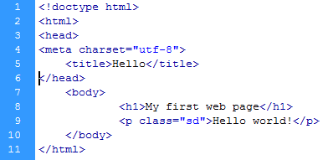
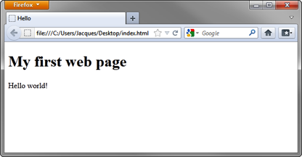
What is HTML?
HTML stands for:
Hypertext
Markup
Language
A markup language, HTML elements are the building blocks of web pages.
HTML elements use tags to structure content.

Slide 3
Tags
HTML elements consist of tags.
Tags are enclosed by angle brackets, like this: <html>
Tags usually come in pairs, like this: <title> and </title>
Tags have a start (or opening) and end (or closing).
Tags are not displayed in a web browser.
Tags interpret how to display content between the tags
<html>
<head>
<title></title>
</head>
<body>
<h1></h1> <p></p>
</body>
</html>

Slide 4
Tags
<html></html> describes the web page.
<head></head> describes the header.
<body></body> describes visible page content.
Common formatting tags:
<h1></h1> displays a heading, ranging from size 1 (biggest) to 6 (smallest).
<p></p> formats text as a paragraph.
<strong></strong> bolds text.
<em></em> emphasizes text.
<i></i>displays as italics.
<br> creates a line break.
Links:
<a href="http://www.example.com"></a> creates a link to a web page.

Slide 5

HTML5
Use HTML5 <!doctype html> to tell a browser how to translate.
Use <meta charset="utf-8"> to tell a browser the character-set.
Use semantic markup tags <article>, <section>, <header>, <nav>, and others to bring a higher level of structural meaning to documents.

Slide 6
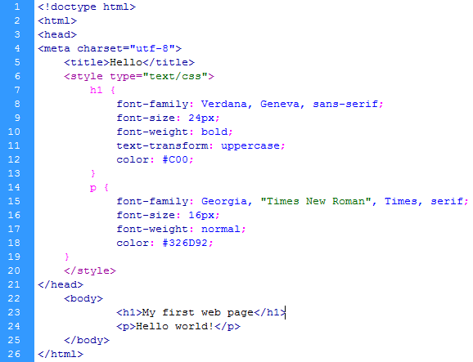
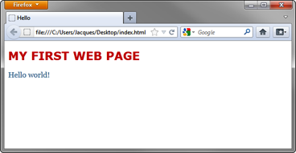
What is CSS ?
CSS stands for:
Cascading
Style
Sheets
Describes the “look and feel” of HTML elements on a web page.
Helps separate document content (HTML) from document presentation (CSS).
Structures presentation elements such as layout, colors, and fonts .

Slide 7
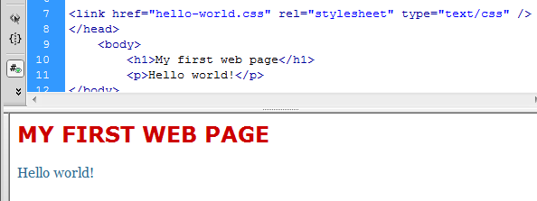
CSS
A style sheet contains a list of rules about how elements appear on a page.
Consists of a selector and a declaration block:
Selectors tell which markup elements the style applies to.
A declaration block is a list of property and value pairs that define the style.
Can be embedded inside the HTML or linked as a separate document.
h1 {
font-family: Verdana, Geneva, sans-serif;
font-size: 24px;
font-weight: bold;
text-transform: uppercase;
color: #C00;
}

Slide 8
SELECTORS
Tag Selectors: Target all instances of an HTML tag (e.g., p selects all paragraphs).
Class Selectors: Target elements with a specific class attribute (e.g., .menu targets elements with class="menu" ).
ID Selectors: Target a unique element with a specific ID (e.g., #header targets the element with id="header" ).

Slide 9
CSS – TEXT DECORATION
Text decoration tags in CSS (text-decoration) control visual effects like underlines, overlines, line-throughs .
(e.g., text-decoration: underline wavy red;).
TYPES
Underline: Adds a line below text . (Eg: text-decoration: underline; )
Overline: Adds a line above text .(Eg: text-decoration: overline;)
Line-through: Strikes through text . (Eg: text-decoration: line-through;)

Slide 10
THANK YOU

